Slide 2
AGGREGATE LOGGING AND CLUSTER MONITORING WITH NUIX AND LOGSTASH
Drew Nase
Integrated Solutions Architect - Nuix

Slide 3

INTRODUCTION
Hi, I’m Drew.
I have been developing software for over twenty years (professionally for about fifteen). I am a member of the Integrated Solutions Team at Nuix.

Slide 4
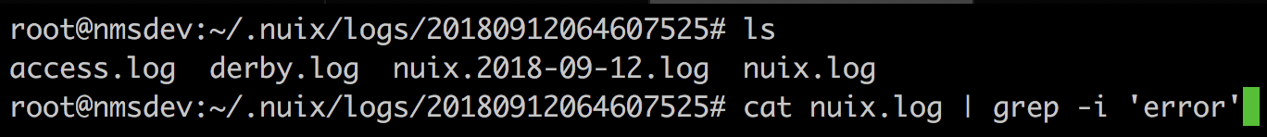
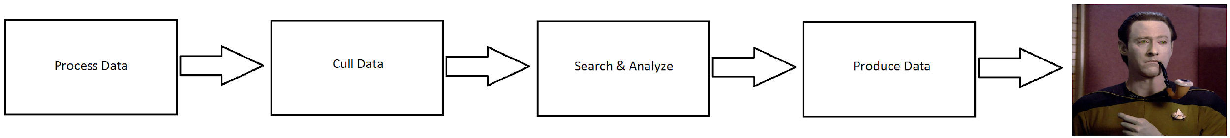
TRADITIONAL MODEL
Simple logging, easy to understand and use
Great for troubleshooting serialized workflows

Slide 5
BUT...
Modern workflows and applications are not serialized.
root@box:~# docker service ls ID NAME MODE REPLICAS i5apmxrmsexw admin-console replicated 1/1 jr6goz3vsvlv admin-console-mariadb replicated 1/1 46jjw8to944q admin-console-ui replicated 1/1 m2miijkoafx5 nginx replicated 1/1 ioi2ge9tg4aw nuix-elasticsearch replicated 3/3 u6wna1get8jf nuix-hazelcast replicated 1/1 wyuo3m5vkdb6 nuix-ims replicated 2/2 ...
How do we figure out which container has the logs we need?

Slide 6
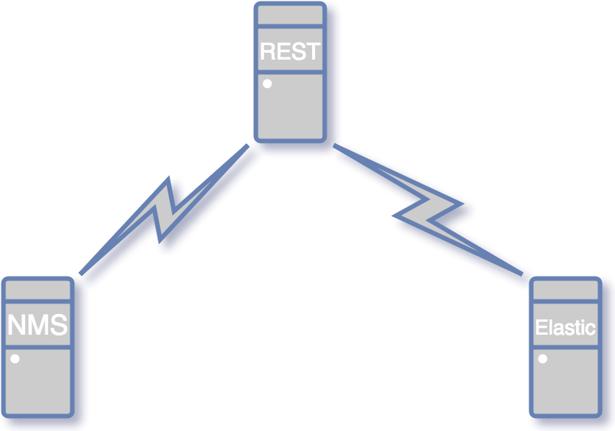
SIMPLE USE CASE

Slide 7
SIMPLE USE CASE
Nuix REST API Endpoint

Slide 8
SIMPLE USE CASE
Nuix REST API Endpoint
Nuix Management Server

Slide 9
SIMPLE USE CASE
Nuix REST API Endpoint
Nuix Management Server
Elastic Cluster

Slide 10
SIMPLE USE CASE
Nuix REST API Endpoint
Nuix Management Server
Elastic Cluster
Scenario: The REST API endpoint is responding with an error. Where should we start looking in order to troubleshoot?

Slide 11
SIMPLE USE CASE
Let’s check the REST API logs.
root@nmsdev:/opt/nuix-restful-service/logs# ls catalina.out localhost_access_log.2018-08-09.txt localhost_access_log.2018-09-12.txt derby.log localhost_access_log.2018-08-20.txt nuix-web.log localhost_access_log.2018-08-07.txt localhost_access_log.2018-09-07.txt nuix-web.log.2018-08-07.zip

Slide 12
SIMPLE USE CASE
Let’s check the REST API logs.
root@nmsdev:/opt/nuix-restful-service/logs# ls catalina.out localhost_access_log.2018-08-09.txt localhost_access_log.2018-09-12.txt derby.log localhost_access_log.2018-08-20.txt nuix-web.log localhost_access_log.2018-08-07.txt localhost_access_log.2018-09-07.txt nuix-web.log.2018-08-07.zip
Hopefully the Elastic logs will be more helpful.
root@esdev:/var/log/elasticsearch/es-esdev# ls elasticsearch_deprecation.log elasticsearch_index_indexing_slowlog.log elasticsearch_index_search_slowlog.log elasticsearch.log gc.log.0.current

Slide 13
SIMPLE USE CASE
Let’s check the REST API logs.
root@nmsdev:/opt/nuix-restful-service/logs# ls catalina.out localhost_access_log.2018-08-09.txt localhost_access_log.2018-09-12.txt derby.log localhost_access_log.2018-08-20.txt nuix-web.log localhost_access_log.2018-08-07.txt localhost_access_log.2018-09-07.txt nuix-web.log.2018-08-07.zip
Hopefully the Elastic logs will be more helpful.
root@esdev:/var/log/elasticsearch/es-esdev# ls elasticsearch_deprecation.log elasticsearch_index_indexing_slowlog.log elasticsearch_index_search_slowlog.log elasticsearch.log gc.log.0.current
Maybe there’s an issue with our license.
root@nmsdev:~/.nuix/logs/20180912064607525# ls
access.log derby.log nuix.2018-09-12.log nuix.log

Slide 14
SIMPLE USE CASE
Let’s check the REST API logs.
root@nmsdev:/opt/nuix-restful-service/logs# ls catalina.out localhost_access_log.2018-08-09.txt localhost_access_log.2018-09-12.txt derby.log localhost_access_log.2018-08-20.txt nuix-web.log localhost_access_log.2018-08-07.txt localhost_access_log.2018-09-07.txt nuix-web.log.2018-08-07.zip
Hopefully the Elastic logs will be more helpful.
root@esdev:/var/log/elasticsearch/es-esdev# ls elasticsearch_deprecation.log elasticsearch_index_indexing_slowlog.log elasticsearch_index_search_slowlog.log elasticsearch.log gc.log.0.current
Maybe there’s an issue with our license.
root@nmsdev:~/.nuix/logs/20180912064607525# ls
access.log derby.log nuix.2018-09-12.log nuix.log
All this log-chasing seems suboptimal. Perhaps there is a better way?
An astute observer might notice that the log locations for all three applications are in completely different places.

Slide 15
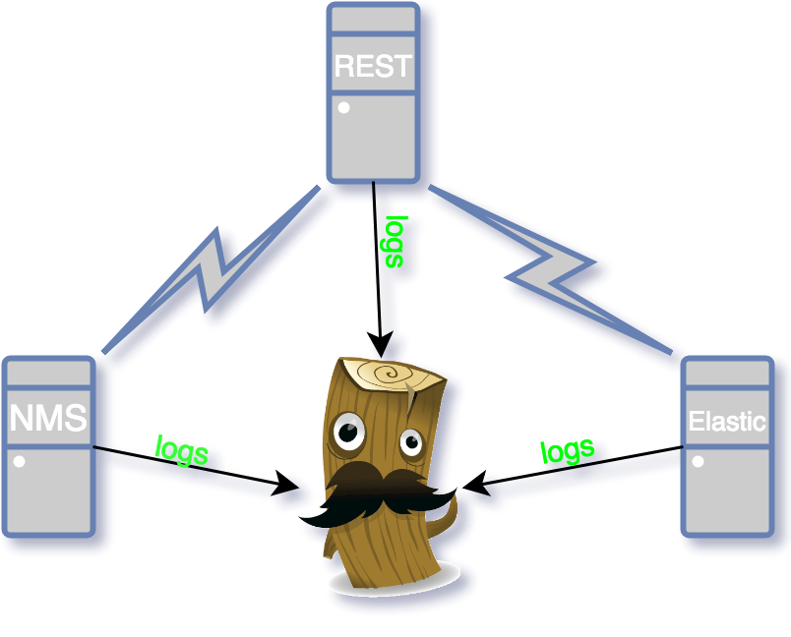
SIMPLE USE CASE

Slide 16
CONFIGURING LOGSTASH
input { beats { port => 5044 } } output { elasticsearch { hosts => "localhost:9200" manage_template => false index => "%{[@metadata][beat]}-%{[@metadata][version]}-%{+YYYY.MM.dd}" document_type => "%{[@metadata][type]}" } }

Slide 17
CONFIGURING FILEBEAT - ELASTIC
filebeat.inputs: - type: log enabled: true paths: - /var/log/elasticsearch/es-esdev/*.log output.logstash: hosts: ["10.0.42.21:5044"]

Slide 18
CONFIGURING FILEBEAT - NUIX WORKBENCH
filebeat.inputs: - type: log enabled: true paths: - /Users/anase01/Library/Logs/Nuix/*/*.log output.logstash: hosts: ["10.0.42.21:5044"]

Slide 19
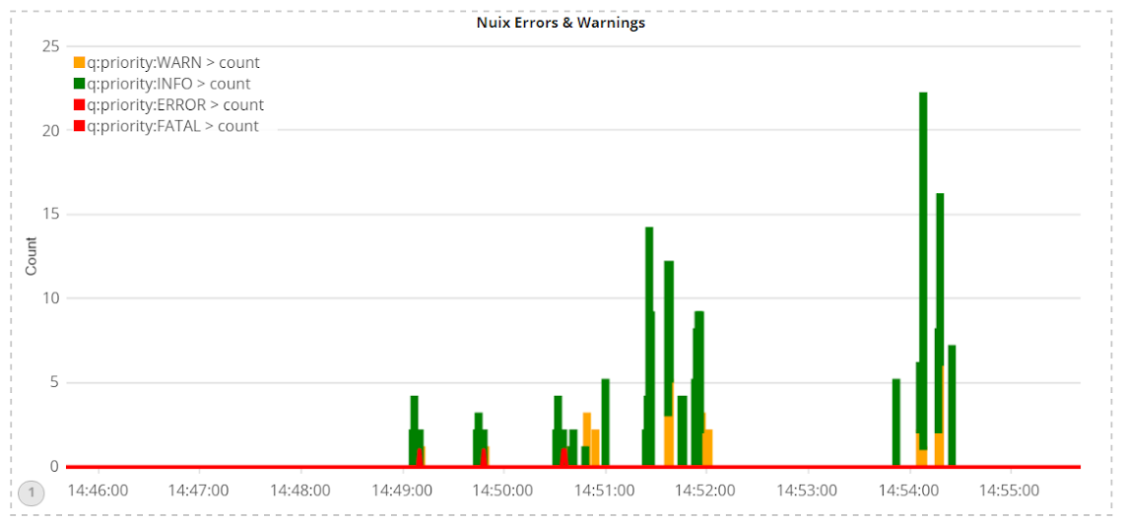
KIBANA IN ACTION - TIMELION
.es(index=filebeat-*,q='*WARN*').yaxis(label="Count").title("Nuix Errors & Warnings").color(orange).bars(),.es(index=filebeat-*,q='*INFO*').color(green).bars(),.es(index=filebeat-*,q='*ERROR*').color(red),.es(index=filebeat-*,q='priority:FATAL').color(red)

Slide 20
Practical Demonstration

Slide 21
SUMMARY
BENEFITS OF AGGREGATED LOGGING WITH LOGSTASH
Logs all in one place - cuts down on troubleshooting time
Ability to visualize application states via Kibana/Timelion
Gain insight into application behavior with real time log streaming
Allows log rotation/deletion, saving disk space without losing any data
https://github.com/dnase
https://github.com/Nuix

Slide 22
Questions?

